Slide 1


Name: Carlos Giovanni Garfias Renjel
Date: December 14 2025

Slide 2

Outline
Executive Summary
Introduction
Methodology
Results
Conclusion
Appendix

Slide 3
Executive Summary
Project Methodologies:
Data Collection: Acquired launch data from the public SpaceX API and supplemented it through web scraping from Wikipedia.
Analysis & Visualization: Conducted exploratory data analysis (EDA) using SQL and statistical plots to identify trends in payload mass, orbit, and launch sites. Create interactive maps with Folium for spatial insights.
Interactive Dashboard: Built a Plotly dashboard with real-time filtering and interactive charts for user exploration.
Predictive Modeling: Developed, tuned, and validated multiple machine learning classifiers using Scikit-learn to predict landing outcomes.
Summary of Results:
A clear learning curve was observed: landing success rates steadily increased with higher flight numbers, reflecting SpaceX’s iterative improvements over time.
Launch Site and Orbit Type emerged as the strongest predictors of landing success — particularly, LEO (Low Earth Orbit) missions achieved the highest success rates.
A predictive machine learning model was successfully trained, with the Decision Tree Classifier achieving 87% accuracy on unseen test data.
The final deliverable includes an interactive Plotly Dash dashboard, enabling dynamic, user-driven exploration of launch data, landing outcomes, and key influencing factors.
Github Url: https://github.com/GiovanniGarfias/IBM-Applied-Data-Science-Capstone/tree/main

Slide 4
Introduction
Project Background & Context
The commercial space launch industry is undergoing a major transformation driven by rocket reusability — a concept pioneered by SpaceX through its Falcon 9 program.By successfully landing and reusing the rocket’s first stage, SpaceX has dramatically reduced launch costs and increased the frequency of space missions.
This groundbreaking innovation has produced a rich dataset of launch records.Analyzing this data offers valuable insights into the key factors influencing landing success or failure, allowing us to apply machine learning to predict and better understand these complex outcomes.
Key Questions to Address
This project focused on answering two main questions using SpaceX launch data:
What factors influence a successful first-stage landing? Is it mainly the launch site, the payload mass, the mission’s orbit, or just experience gained over time?
Can we predict future landings? Based on past launches, can we train a machine learning model that accurately predicts whether a Falcon 9 will land successfully or not?

Slide 5

Section 1

Slide 6
Methodology
Executive Summary
Data collection methodology:
Retrieve information from Spacex Rest API
Web-scraping data from wikipedia
Perform data wrangling
We processed the data by imputing the missing payload values, filtering for Falcon 9 launches, and creating the binary class target variable (1=success, 0=failure)
Perform exploratory data analysis (EDA) using visualization and SQL
Perform interactive visual analytics using Folium and Plotly Dash
Perform predictive analysis using classification models
How to build, tune, evaluate classification models

Slide 7
Data Collection
The launch data used in this project was collected from multiple public sources.
First, I accessed the SpaceX REST API to retrieve structured information about Falcon 9 launches.
Then, I used web scraping (BeautifulSoup) to gather additional details from Wikipedia, including booster versions and landing outcomes not available directly through the API.
All datasets were combined and cleaned to create a single unified dataframe for analysis, visualization, and modeling.
API Data
Web Scraping
Merge Data
Clean Data
Final Dataset
Encoding
Feature Engineering

Slide 8
Data Collection – SpaceX API
Slide Text (short & clean)
Launch data was collected directly from the SpaceX REST API, which provides JSON records of all Falcon 9 missions.
API responses were parsed and normalized into a Pandas DataFrame using requests.get() and json_normalize().
The API provided key information such as launch dates, payload mass, orbit type, booster version, and landing outcomes.
These structured records formed the foundation of the full dataset, later enriched with additional scraped data.
See the full notebook here.
SpaceX REST API endpoint
JSON Response
Normalize to DataFrame
Structured dataset ready
Extract key launch fields

Slide 9
Data Collection - Scraping
To complement the SpaceX API data, I performed web scraping on the Falcon 9 & Falcon Heavy launch page from Wikipedia.
Using Requests and BeautifulSoup, I extracted the launch table containing booster versions, landing outcomes, payload details, and mission metadata.
The HTML table was parsed and converted into a Pandas DataFrame, followed by column cleanup and formatting.
This scraped dataset provided additional fields not included in the API and was later merged with the API dataset to build a complete launch history.
See the complete notebook here.
Wikipedia launch page
Requests: Get HTML content
BeautifulSoup: Parse table
Extract rows and columns
Convert to DataFrame
Clean and format columns
Merge with API dataset

Slide 10
Data Wrangling
After collecting the API and Wikipedia data, I combined both sources into a single unified dataset.
Performed initial cleaning, including dropping irrelevant columns, standardizing text fields, and fixing inconsistent formats.
Handled missing values by removing incomplete rows and aligning columns between the API and scraped data.
Applied feature processing, such as converting datatypes, extracting useful fields, and preparing numerical and categorical attributes.
Finalized a clean, structured DataFrame ready for EDA and machine learning.
See the complete notebook here.

Slide 11
Data Wrangling
Data Wrangling flowchart
API Dataset
Scraped dataset
Merge both sources
Clean columns and fix formats
Final clean dataset
Feature processing
Handle missing values

Slide 12
EDA with Data Visualization
Scatter Plot (Payload Mass vs Landing Outcome): Used to check whether heavier or lighter payloads affect landing success.
Bar Charts (Launch Site vs Success Rate): Helped compare performance across different launch sites to see which locations showed higher landing reliability.
Boxplots (Orbit Type vs Payload Mass): Used to understand how payload mass varies by orbit, and whether orbit type influences landing outcomes.
Heatmap (Correlation Matrix): Visualized relationships between numerical variables to identify possible predictors for the model.
Trend Plot (Flight Number vs Success Rate): Helped show the learning curve over time, indicating improvement in landing outcomes as SpaceX gained experience.
See the complete notebook here.

Slide 13
EDA with SQL
Connected to the SQLite database
Removed any old table version using: DROP TABLE IF EXISTS.
Created a clean working table (SPACEXTABLE) selecting only rows with a valid date.
Retrieved all distinct launch sites to understand the categorical space.
Previewed sample records using filters (LIKE 'CCA%') to verify consistency.
Performed a full-table check to confirm column availability and data ranges.
Calculated the total payload mass for NASA missions (SUM).
Computed the average payload for a specific booster version (AVG).
Identified the earliest successful ground pad landing (MIN on Date).
See the complete notebook Github URL here:

Slide 14
EDA with SQL
Counted the number of launches per mission outcome (GROUP BY).
Counted landing outcomes within a specific timeframe (date filtering).
Compared the number of launches per launch site.
Retrieved the booster version associated with the heaviest payload (subquery using MAX).
Extracted monthly landing outcomes for a specific year using substr() to manipulate dates.
Performed targeted filters to explore “False ASDS” landings in a given year.
See the complete notebook Github URL here:

Slide 15
Build an Interactive Map with Folium
Map Objects Added
Launch Site Circles: Visual markers highlighting the exact geographic location of each launch site.
Text Labels (DivIcon): Small labels added next to each site to clearly identify its name without clicking.
Outcome Markers (Success/Fail): Individual launch points plotted on the map using:
Green markers → successful landings (class = 1)
Red markers → failed landings (class = 0) Grouped using a MarkerCluster to prevent overlap.
Distance Lines (PolyLines): Straight lines drawn between each launch site and nearby features such as: coastline, highways, and railway tracks.
Distance Markers: Custom text markers using DivIcon displaying exact distances (e.g., “5.23 KM”).
See the complete notebook Github URL here.

Slide 16
Build a Dashboard with Plotly Dash
What interactive plots and components were added
Launch Site Dropdown Menu: Allows selecting All Sites or any individual launch site to dynamically filter the charts.
Success Pie Chart: Automatically updates based on the dropdown selection, showing: • Total successes per site (when All Sites is selected) • Success vs. failure distribution for a specific site
Payload Range Slider: Lets the user interactively filter launches based on payload mass (0–10,000 kg).
Payload vs. Outcome Scatter Plot: Displays the relationship between payload size and landing outcome. Points are color-labeled by Booster Version Category to reveal additional patterns.
Why these components were added
The dropdown enables quick comparison of launch success across sites and deeper inspection of each site’s performance.
The pie chart provides an intuitive, high-level view of success rates.
The range slider helps explore how payload mass influences mission outcomes.
The scatter plot reveals potential correlations between payload, success rate, and booster type, supporting deeper visual analysis. See the Dashboard Github URL here.

Slide 17
Predictive Analysis (Classification)
How the classification model was built and selected
Feature Preparation: Selected engineered numerical and one-hot encoded features related to flight history, payload, orbit, launch site, and landing conditions.
Data Standardization: Applied StandardScaler to normalize feature scales and improve model convergence.
Train–Test Split: Split the dataset into training (80%) and test (20%) sets to evaluate generalization on unseen data.
Model Training: Trained four classification models:
Logistic Regression
Support Vector Machine (SVM)
Decision Tree
K-Nearest Neighbors (KNN)
Hyperparameter Optimization: Used GridSearchCV (cv = 10) to systematically tune hyperparameters for each model.
Model Evaluation: Evaluated all models on the test set using Accuracy and F1-score to ensure balanced performance.
Model Selection: All models achieved identical test performance. Logistic Regression was selected as the final model due to its simplicity, interpretability, and computational efficiency.
See the complete notebook Github URL here.

Slide 18
Predictive Analysis (Classification)
Predictive Analysis flowchart
Raw Data
Feature Engineering and Encoding
Standarization
(StandarScaler)
Train-Test Split
Final model selection
Model Evaluation (Accuracy and F1-score)
Hyperparameter Tuning (GridSearchCV)
Model Training (LR, SVM, DT, KNN)

Slide 19
Results
Exploratory data analysis results
Interactive analytics demo in screenshots
Predictive analysis results

Slide 20

Section 2

Slide 21
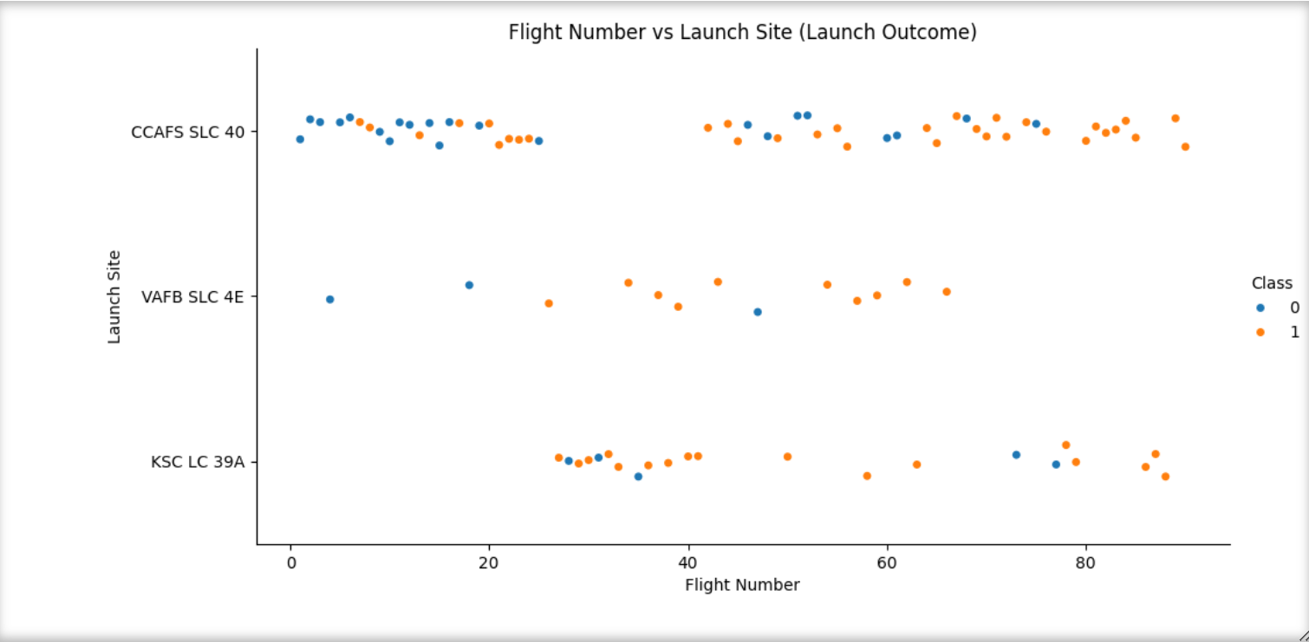
Flight Number vs. Launch Site
This scatter plot shows launch outcomes by flight number and launch site. CCAFS SLC-40 has the highest number of launches and demonstrates a strong improvement in landing success over time. VAFB SLC-4E has fewer launches but still shows a positive success trend, while KSC LC-39A displays a moderate number of attempts with increasing successful landings. Overall, all sites exhibit a clear learning effect as flight experience increases.

Slide 22
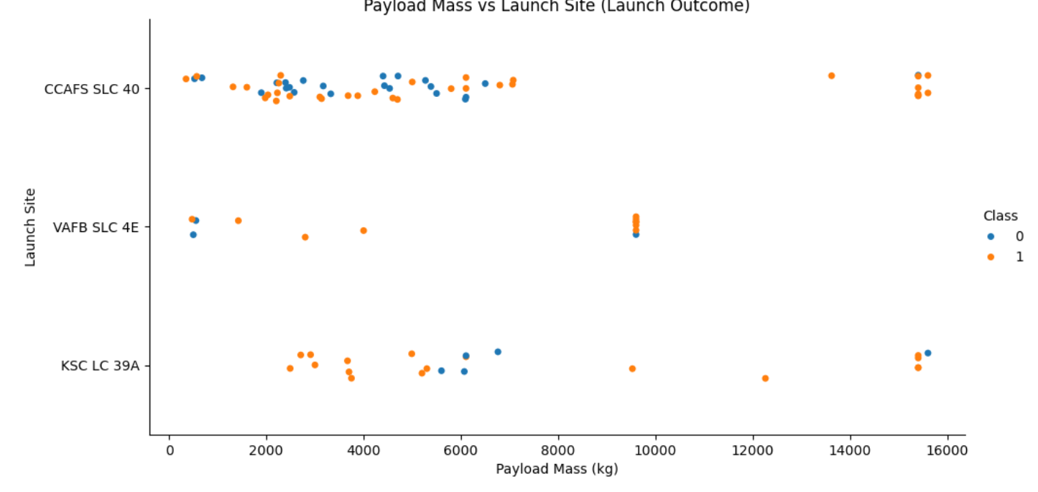
Payload vs. Launch Site
This scatter plot shows the relationship between payload mass and launch site, with launch outcomes highlighted by color. KSC LC-39A is associated with higher payload missions and demonstrates a higher proportion of successful landings. CCAFS SLC-40 covers a wide payload range and shows improving success rates, while VAFB SLC-4E has fewer launches with more constrained payload values. These patterns suggest that both payload mass and launch site are relevant factors influencing landing success.

Slide 23
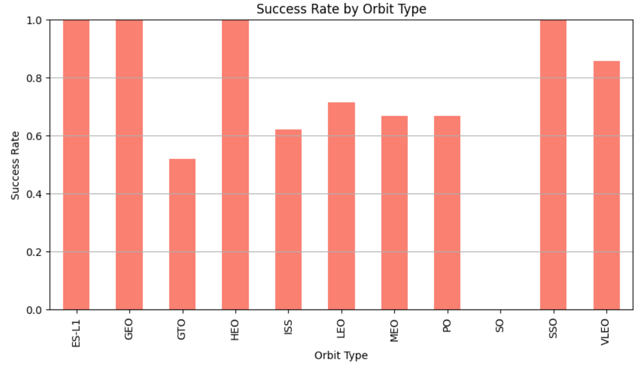
Success Rate vs. Orbit Type
This bar chart shows the landing success rate for each orbit type. Low Earth Orbit (LEO) and ISS missions achieve noticeably higher success rates, while more demanding orbits such as GTO and HEO show lower success rates. This suggests that orbit type is a significant factor influencing landing performance and should be considered an important feature in predictive modeling.

Slide 24
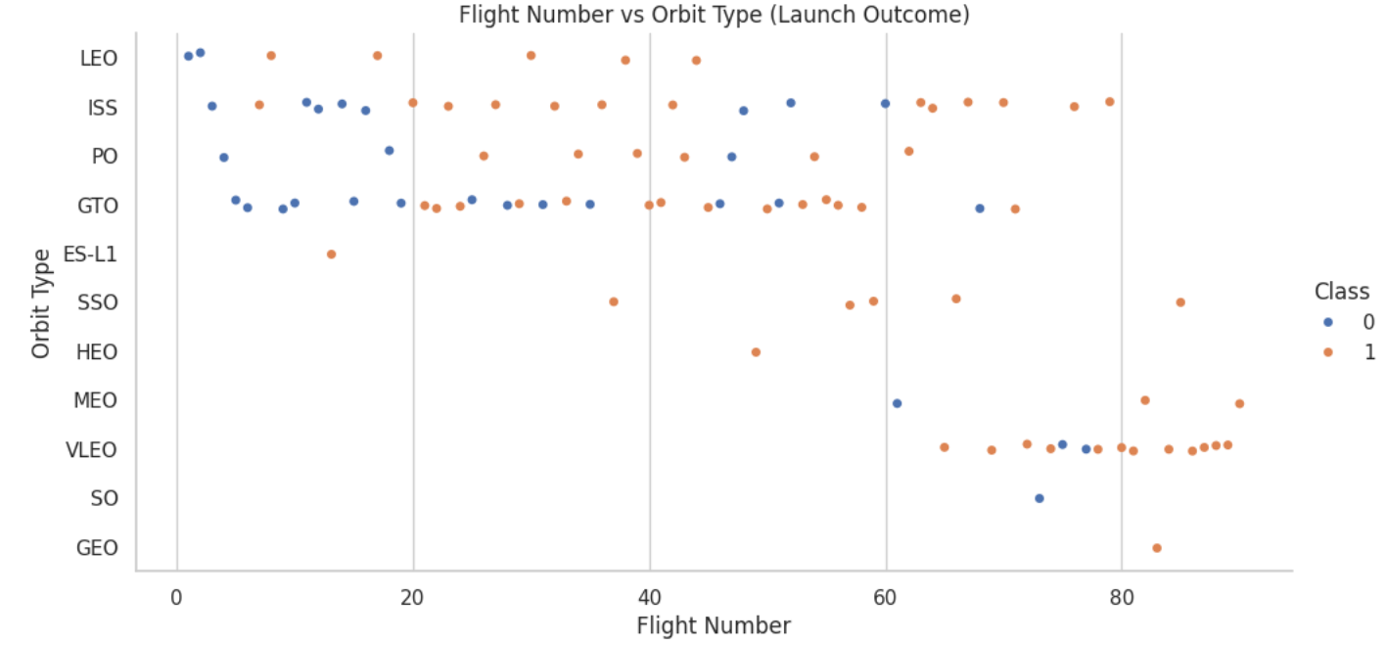
Flight Number vs. Orbit Type
This scatter plot illustrates the relationship between flight experience and orbit type, with landing outcomes shown by color. Early flights across most orbit types exhibit higher failure rates, while later flights show a clear increase in successful landings. Simpler missions such as LEO and ISS reach higher success levels earlier, whereas more complex orbits improve more gradually. This highlights the combined effect of operational experience and orbit complexity on landing success.

Slide 25
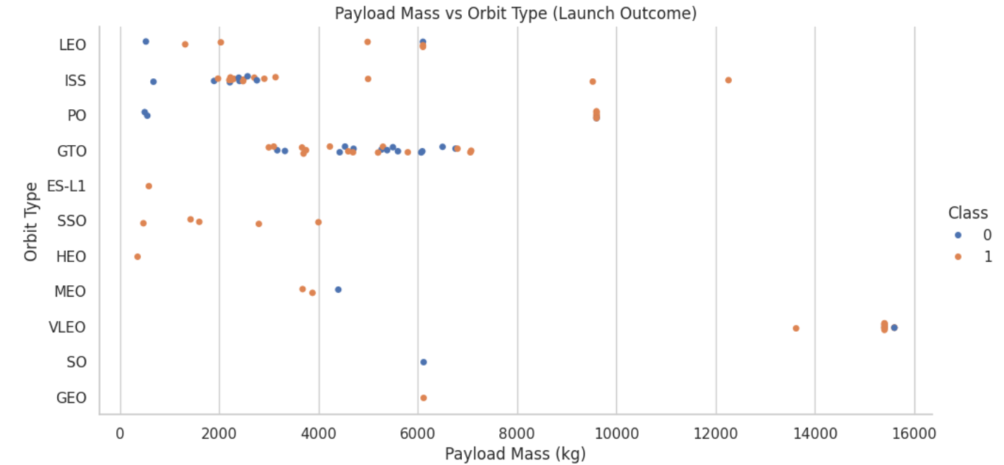
Payload vs. Orbit Type
This scatter plot shows the relationship between payload mass and orbit type, with landing outcomes highlighted by color. Missions to simpler orbits such as LEO and ISS achieve high success rates across a broad payload range, while more demanding orbits like GTO exhibit lower success, particularly at higher payload masses. These patterns indicate that both payload mass and orbit type jointly influence landing performance.

Slide 26
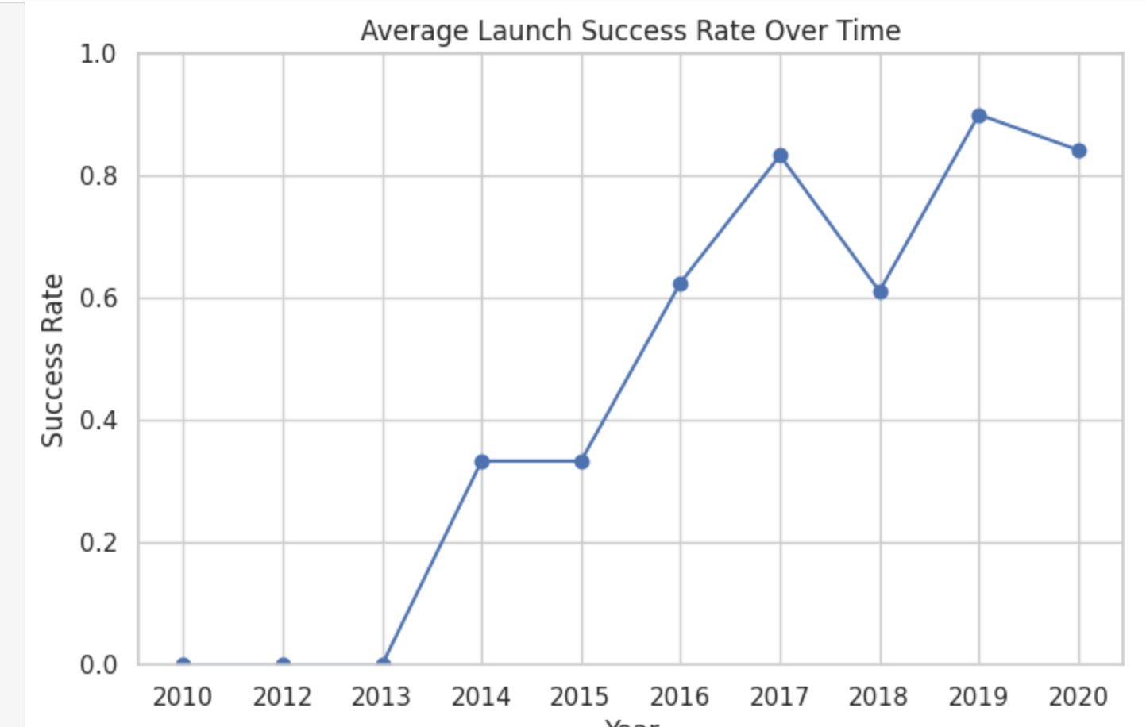
Launch Success Yearly Trend
This line chart shows the average annual launch success rate. Early years exhibit lower success rates, while later years demonstrate a clear and consistent improvement. This trend highlights SpaceX’s operational learning curve and increasing reusability reliability over time.

Slide 27
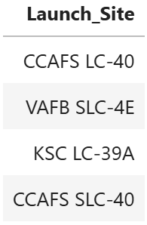
All Launch Site Names
This query retrieves the distinct launch sites from the SpaceX missions dataset. The result confirms that SpaceX operates launches from four different launch locations, which are later analyzed to evaluate their impact on mission success rates.

Slide 28
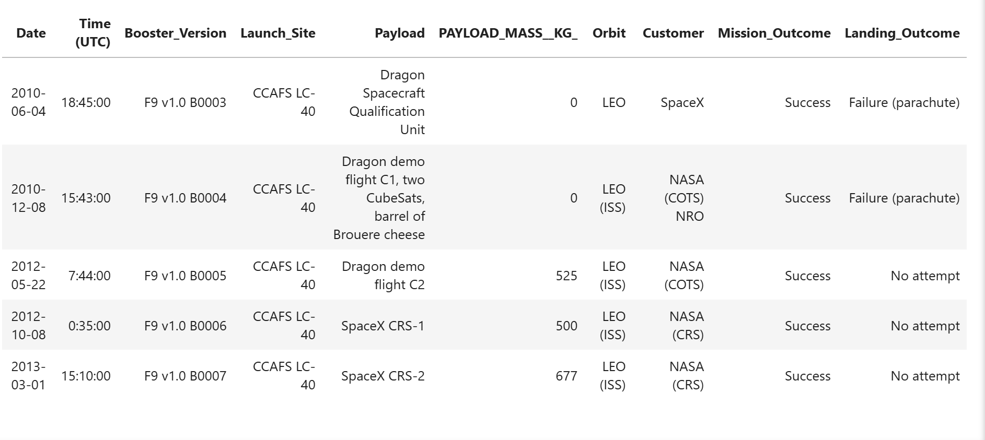
Launch Site Names Begin with 'CCA'

Slide 29
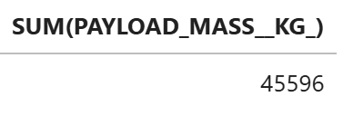
Total Payload Mass
The query computes the total payload mass delivered by SpaceX during NASA CRS missions, highlighting the scale of cargo transported for NASA.

Slide 30
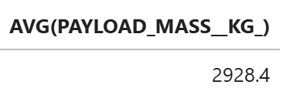
Average Payload Mass by F9 v1.1
The query calculates the average payload mass carried by the Falcon 9 v1.1 booster, summarizing its typical launch capacity.

Slide 31
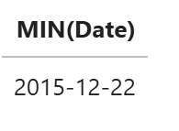
First Successful Ground Landing Date
This query identifies the earliest date on which SpaceX achieved a successful ground pad landing. By filtering records with a successful ground pad outcome and applying the MIN function to the launch date, the result highlights a key milestone in SpaceX’s reusability program.

Slide 32
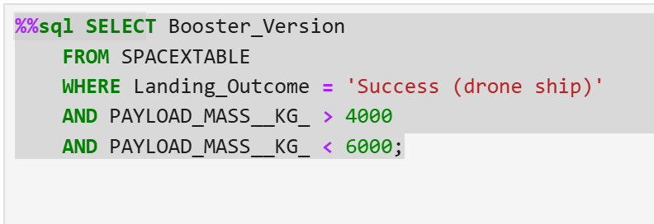
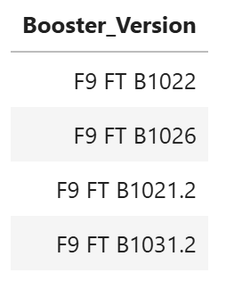
Successful Drone Ship Landing with Payload between 4000 and 6000
This query lists the booster versions that achieved a successful landing on a drone ship while carrying a payload mass between 4000 kg and 6000 kg. By combining landing outcome and payload constraints, the query identifies booster configurations that performed successfully under medium-to-heavy payload conditions.

Slide 33
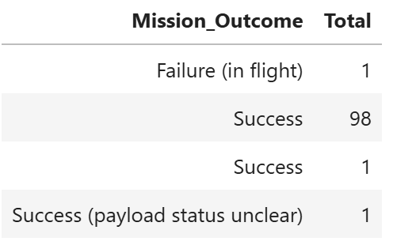
Total Number of Successful and Failure Mission Outcomes
This query groups all SpaceX missions by their mission outcome and counts the total number of missions in each category. The result provides an overall comparison between successful and failed missions, offering a high-level view of SpaceX mission reliability.

Slide 34
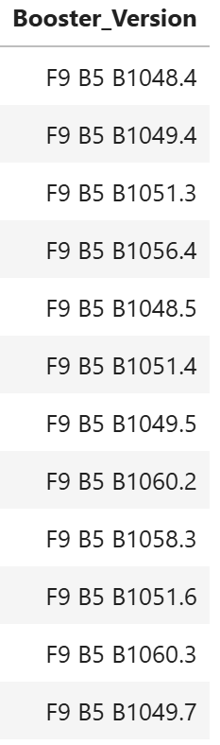
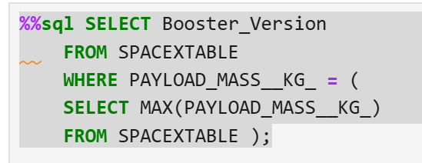
Boosters Carried Maximum Payload
This query identifies the booster versions that carried the maximum payload mass in SpaceX missions. A subquery is used to first determine the highest payload mass in the dataset, and the outer query then retrieves all booster versions associated with that payload value.

Slide 35
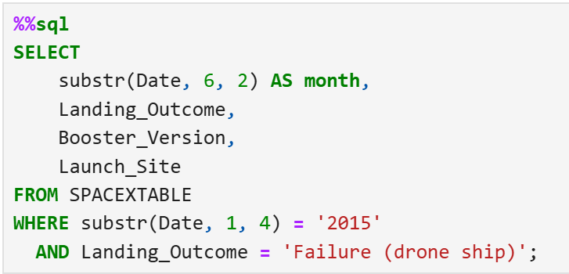
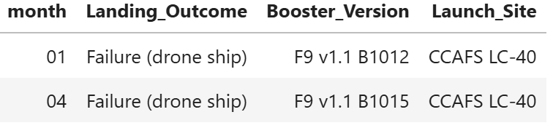
2015 Launch Records
This query filters the dataset to select missions from the year 2015 with failed drone ship landings. By extracting the year and month from the launch date and filtering by a specific landing outcome, the result shows the month, booster version, and launch site for unsuccessful drone ship landings during 2015.

Slide 36
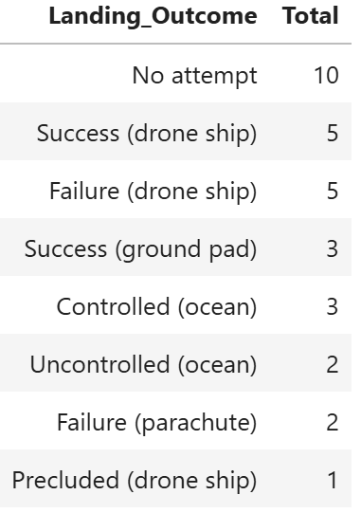
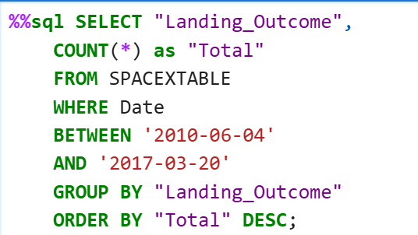
Rank Landing Outcomes Between 2010-06-04 and 2017-03-20
This query ranks landing outcomes by their total count for SpaceX launches occurring between June 4, 2010 and March 20, 2017. By grouping missions by landing outcome and ordering them in descending order, the result highlights the most frequent landing results during the early reusability era.

Slide 37

Section 3

Slide 38
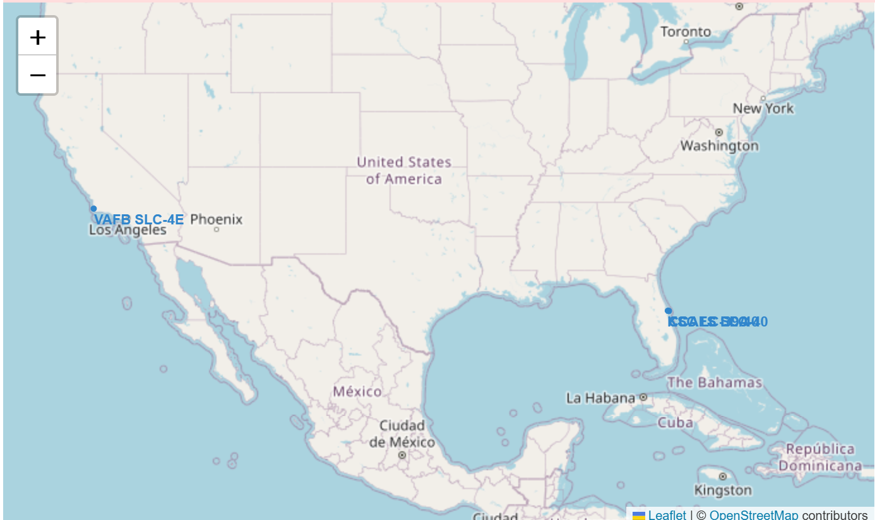
SpaceX Launch Sites – Geographic Distribution
This map shows the geographic locations of SpaceX launch sites across the United States. Each marker represents a distinct launch site, allowing a clear comparison of their spatial distribution.
The visualization highlights that all launch sites are located near coastal areas, which is strategically important for safety and launch logistics. In addition, the sites are spread across different latitudes, supporting a variety of mission profiles and orbital inclinations.*

Slide 39
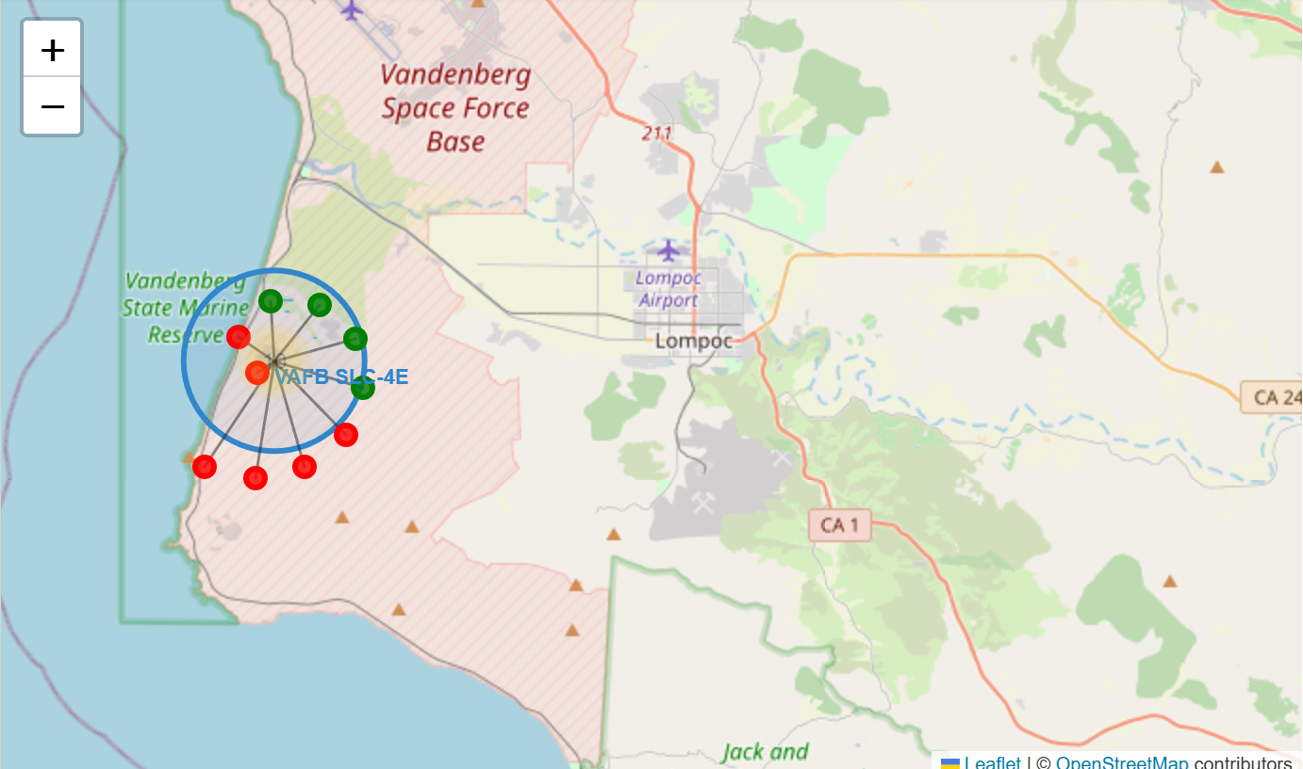
Color-Coded Launch Outcomes by Site
This interactive map displays SpaceX launch outcomes across all launch sites using color-coded markers. Each marker represents an individual launch attempt, where green markers indicate successful landings and red markers indicate failed landings.
Marker clustering is used to group launches occurring at the same site, making it easier to visualize the overall proportion of successes and failures at each location. The map allows direct visual comparison of launch performance across different sites.

Slide 40
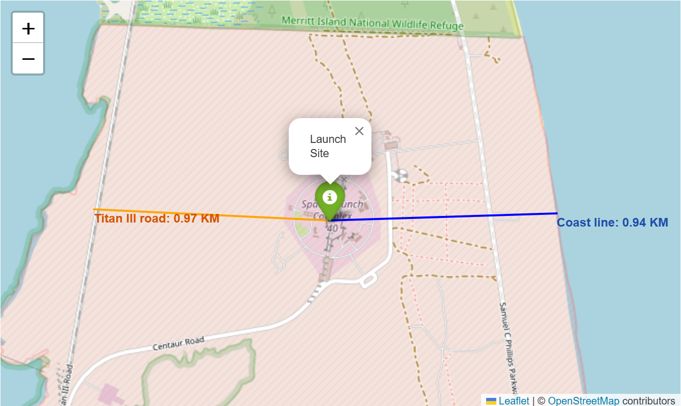
Launch Site Proximity to Coastline and Infrastructure
This map shows the distance from the launch site to two key reference points: the coastline and Titan III Road. Orange and blue polylines connect the launch pad to each location, while labeled markers display the distances in kilometers. This highlights how close the launch infrastructure is to both coastal safety zones and nearby ground transportation routes.

Slide 41

Section 4

Slide 42
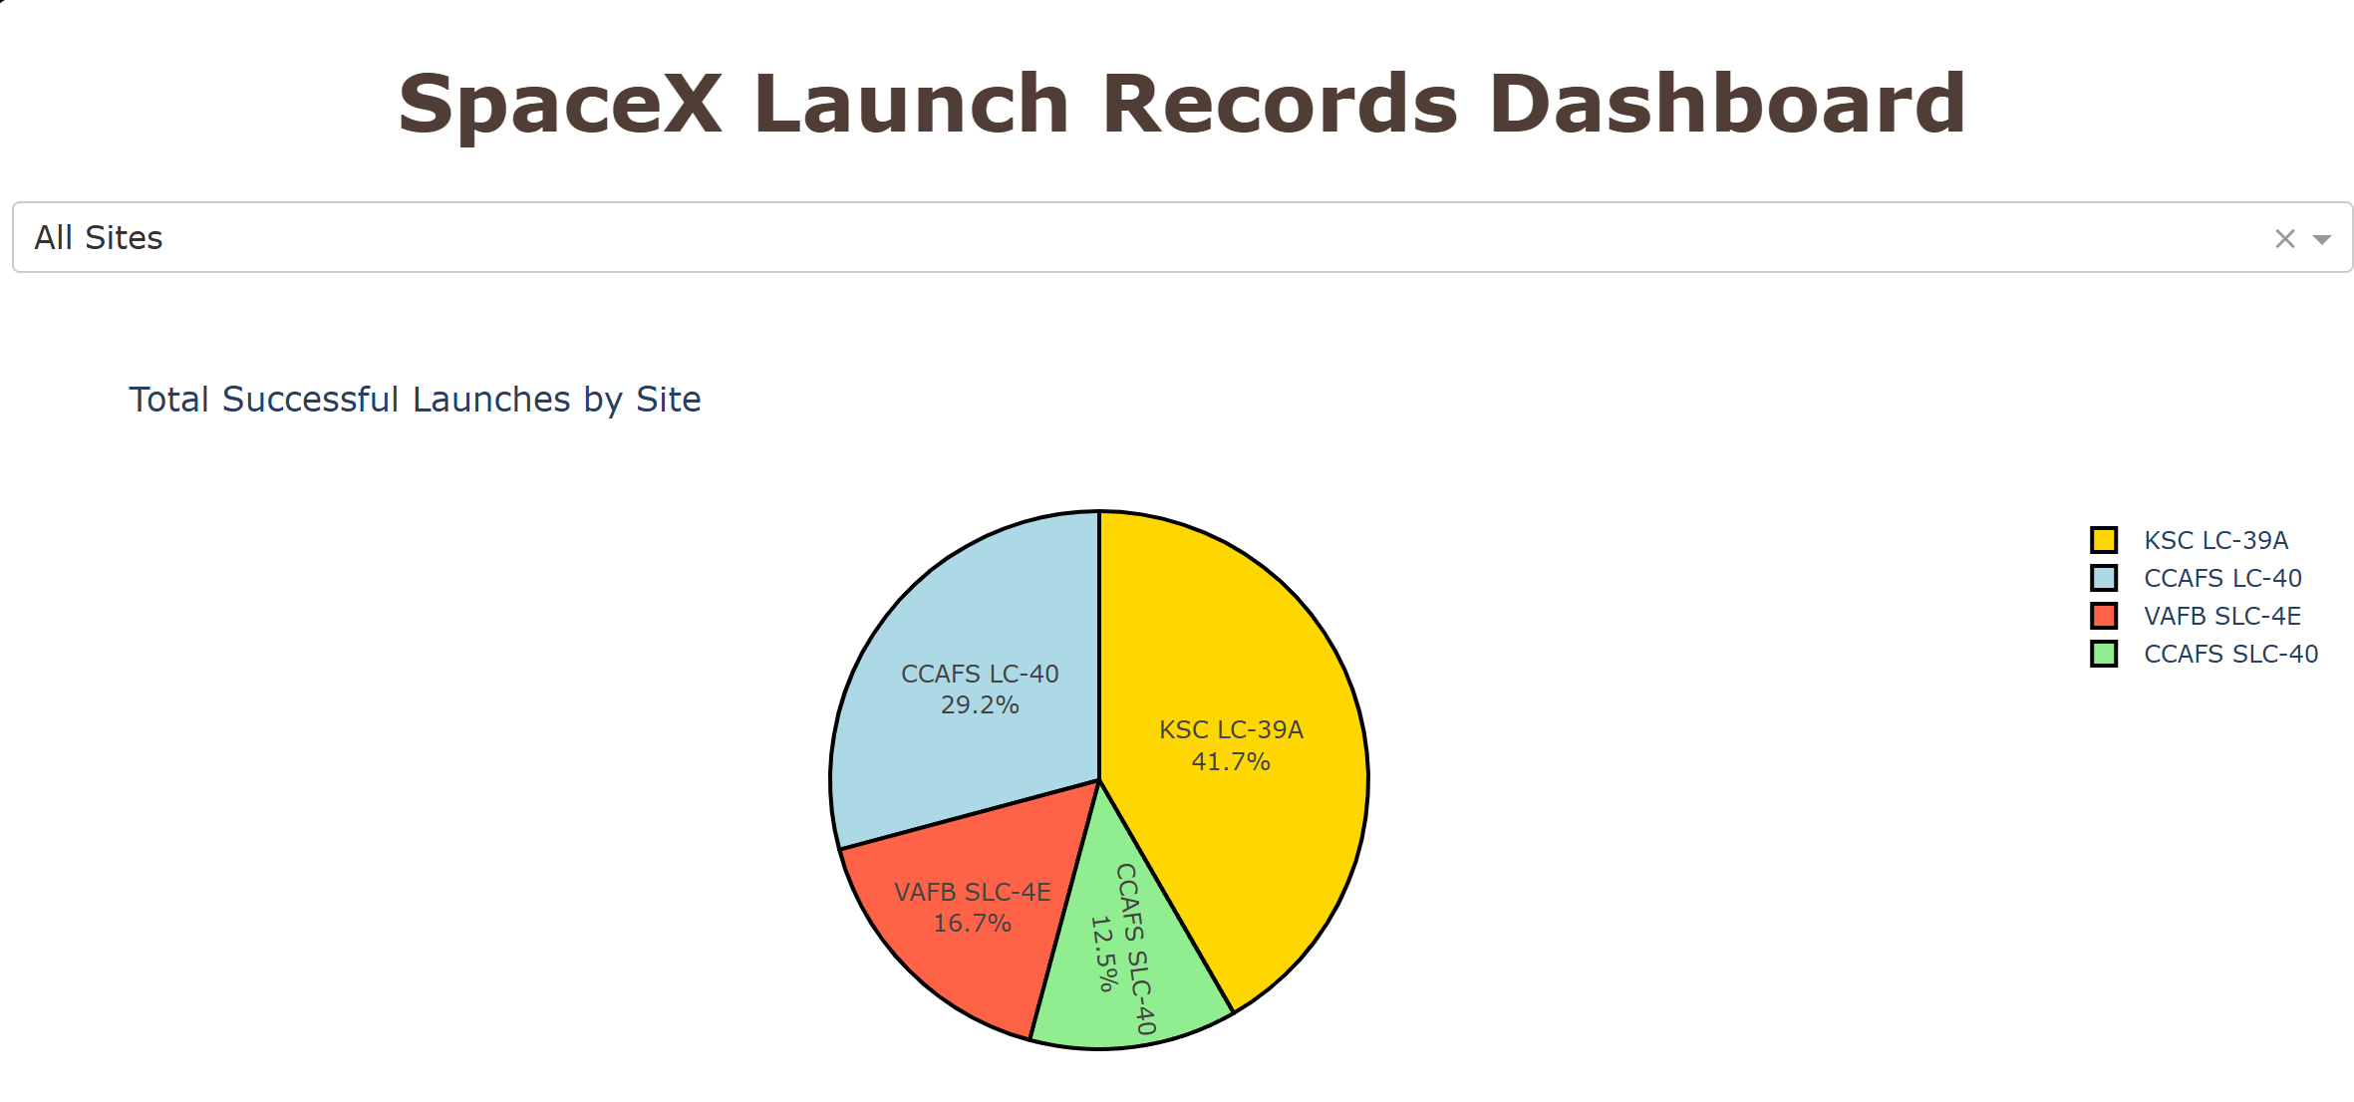
Successful Launch Share Across SpaceX Sites
This dashboard shows the distribution of successful launches across all SpaceX launch sites. The dropdown at the top is set to “All Sites”, and the pie chart displays the proportion of successful missions contributed by each location.
KSC LC-39A accounts for the largest share of successful launches (about 42%), followed by CCAFS LC-40 (~29%), VAFB SLC-4E (~17%), and CCAFS SLC-40 (~12%). This visualization highlights that launch activity and success are not evenly distributed across sites, with KSC LC-39A playing a particularly important role in successful missions

Slide 43
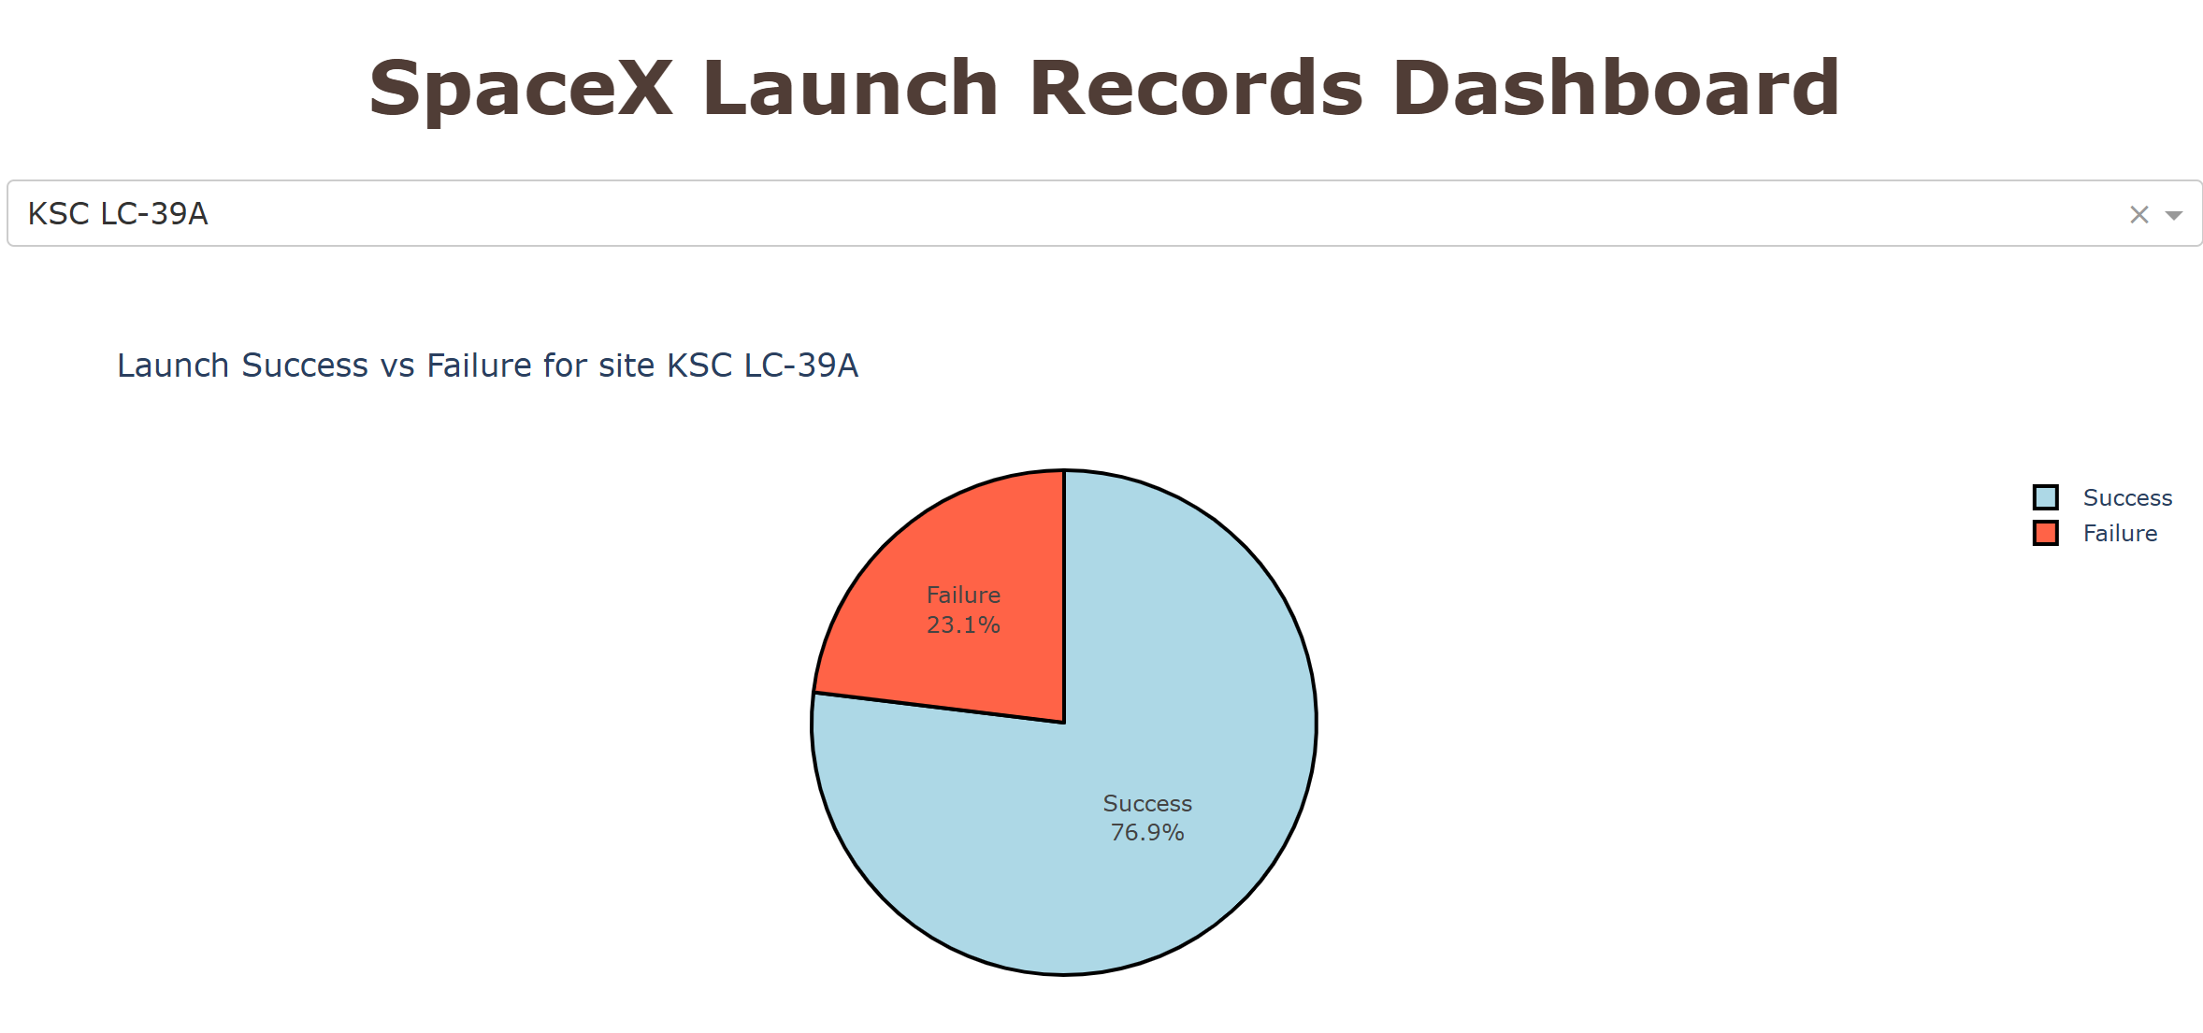
Launch site with the highest success ratio
This pie chart shows the success rate for launches at KSC LC-39A, the site with the highest total number of successful launches overall. When focusing only on this site, approximately 77% of launches were successful, while 23% resulted in failure, indicating a high reliability level for KSC LC-39A.

Slide 44
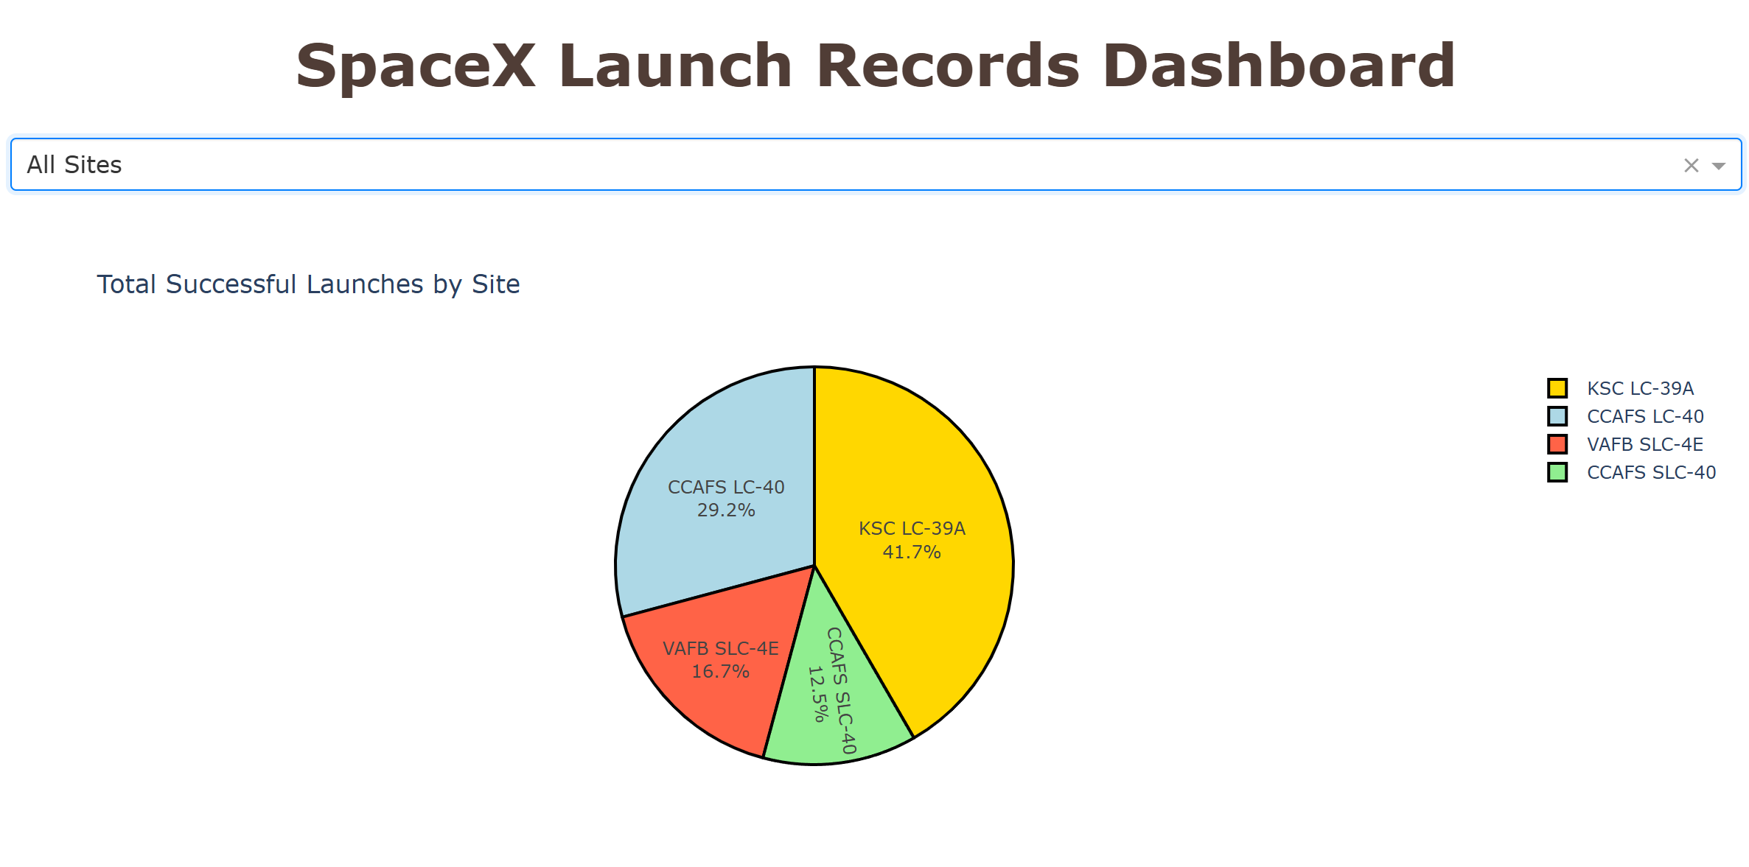
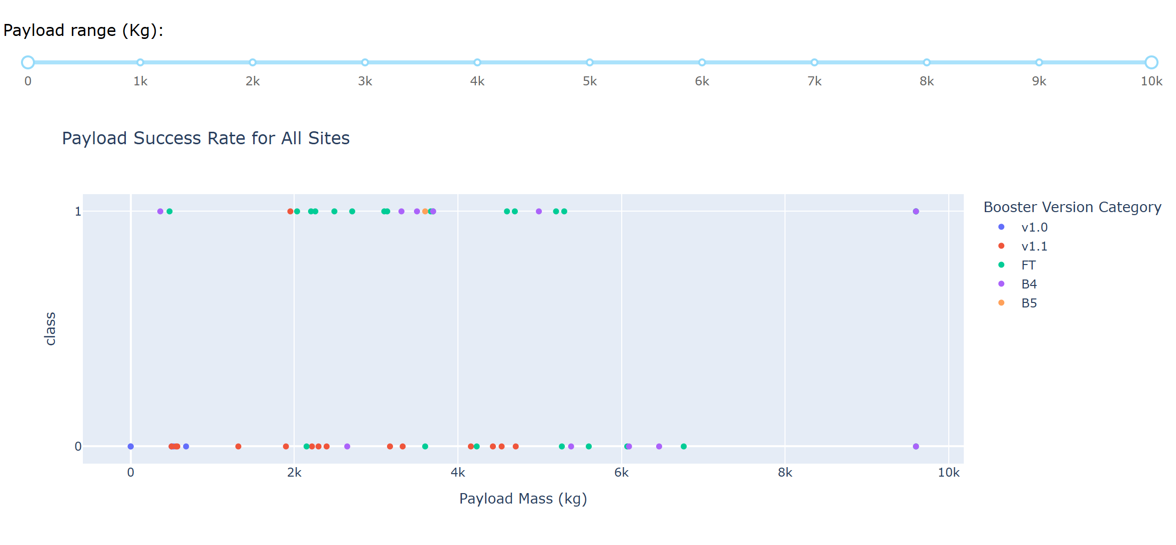
Key insights from the SpaceX launch data dashboard
This dashboard summarizes key insights obtained from the interactive SpaceX launch data dashboard. By combining launch site selection, payload range filtering, and visual comparisons, the dashboard reveals clear patterns in launch success behavior.
The analysis shows that launch success varies across sites, with KSC LC-39A contributing the highest number of successful launches. Additionally, payload mass plays an important role in mission outcomes, with higher success rates observed in specific payload ranges. The visualization also highlights improved reliability when using newer booster versions, such as FT, B4, and B5.
Overall, the dashboard enables interactive exploration of how launch site, payload mass, and booster technology jointly influence launch success

Slide 45

Section 5

Slide 46
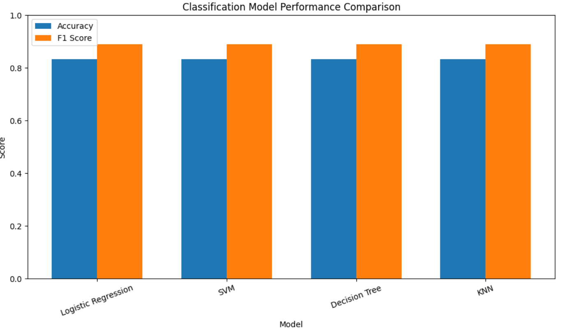
Classification Accuracy
This chart compares the performance of four classification models—Logistic Regression, Support Vector Machine (SVM), Decision Tree, and K-Nearest Neighbors (KNN)—using both accuracy and F1-score on the test dataset.
All models achieved a similar performance, with an accuracy of approximately 83% and an F1-score close to 0.89. This indicates that the engineered features provide strong predictive signals and that the landing success prediction task is not highly sensitive to the choice of classification algorithm.
Since no single model clearly outperformed the others, the final model selection was based on factors such as simplicity, interpretability, and robustness rather than marginal differences in performance.

Slide 47
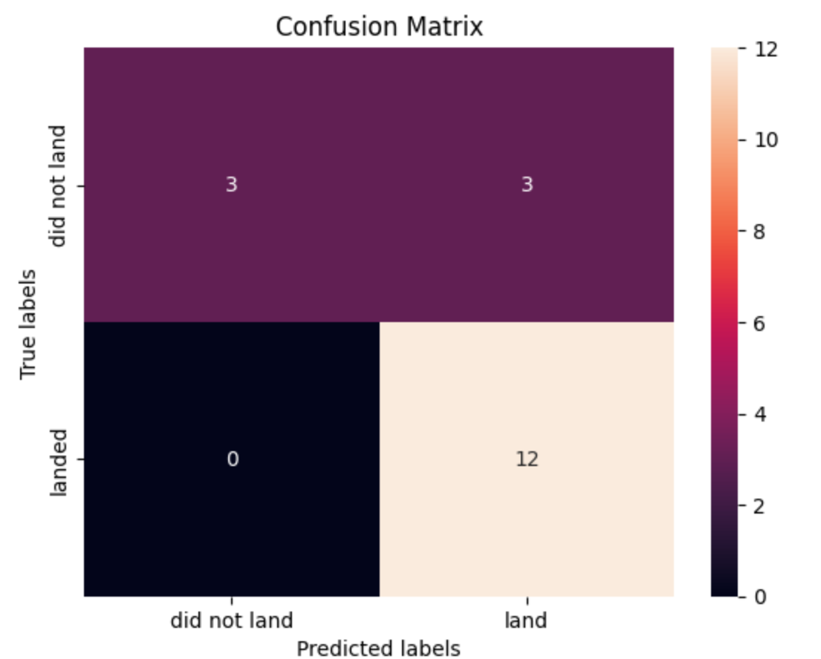
Confusion Matrix
The confusion matrix illustrates the performance of the Logistic Regression model on the test dataset by comparing predicted outcomes with the true landing results.
The model correctly predicted 12 successful landings (true positives) and 3 failed landings (true negatives). There were 3 false positives, where the model predicted a successful landing that did not occur, and no false negatives, meaning the model never misclassified a successful landing as a failure.
This result shows that the model is particularly effective at identifying successful landings, which is reflected in the high accuracy and F1-score. The confusion matrix confirms that the Logistic Regression model provides reliable and balanced predictions for this classification task
Logistic Regression :
Accuracy : 0.8333
F1 Score : 0.8889

Slide 48
Conclusions
Operational Experience and Technology Improvements Launch success rates increased over time as SpaceX gained operational experience and introduced improved Falcon 9 booster versions, particularly FT, B4, and B5.
Impact of Launch Site and Payload Mass Mission outcomes are influenced by both launch site and payload mass. KSC LC-39A accounted for the highest number of successful launches, and specific payload ranges consistently showed higher success rates, supporting their relevance as predictive features.
Insights from Interactive and Geospatial Analysis Interactive dashboards and geospatial visualizations enabled deeper exploration of how launch site location, payload mass, and booster configuration interact, revealing important operational patterns.
Robust Machine Learning Results All evaluated classification models achieved stable and consistent performance. The similarity in accuracy and F1-scores highlights the effectiveness of the feature engineering process. Logistic Regression was selected as the final model due to its simplicity, interpretability, and reliable predictive behavior.

Slide 49
Ackownledgements
I would like to thank Coursera and IBM for providing the tools, learning materials, and guidance that made this project possible. Special thanks to the instructors and content creators of the IBM Data Science Professional Certificate for their clear explanations and practical approach to data science and machine learning.
Giovanni Garfias IBM Applied Data Science Capstone

Slide 50


